Slide 1
NP-Completeness Dr. Tathagata Ray Assistant Professor, BITS Pilani, Hyderabad Campus rayt@hyderabad.bits-pilani.ac.in

Slide 2
CLIQUE
A clique is an undirected graph is a subgraph, wherein every two nodes are connected by an edge. A k-clique is a clique that contains k nodes.
Decision Problem: Given a graph G and an integer k, whether there is a clique in G of size at least k.

Slide 3
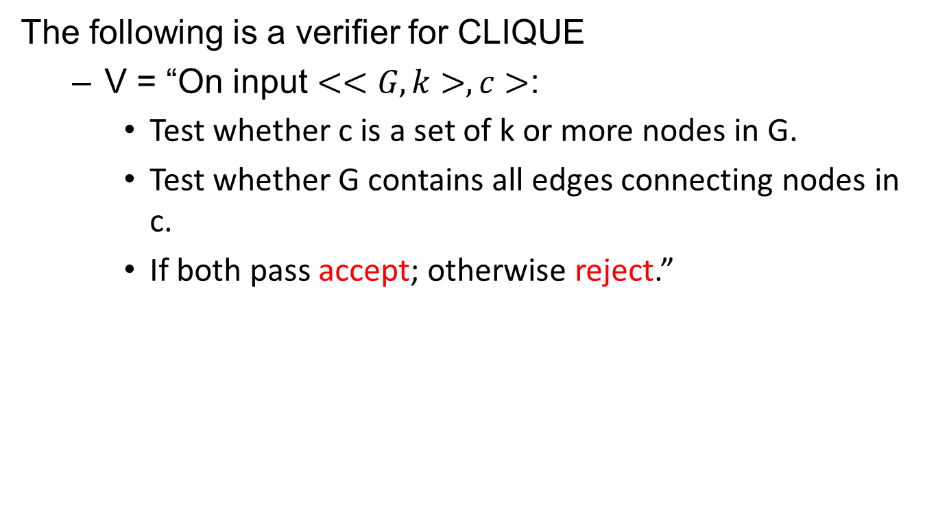
Step 1: CLIQUE is in NP
The following is a verifier for CLIQUE
V = “On input $<<G,k>,c>$:
Test whether c is a set of k or more nodes in G.
Test whether G contains all edges connecting nodes in c.
If both pass accept; otherwise reject.”

Slide 4

3-SAT ≤_{p} CLIQUE
3-SAT is polynomial time reducible to CLIQUE.
Let $φ$ be a formula with k clause.
$φ=(a_{1}∨b_{1}∨c_{1})∧$ $\left(a_{2}∨b_{2}∨c_{2}\right)∧ …∧\left(a_{k}∨b_{k}∨c_{k}\right).$
Reduction function $f$ generates the string $<G,k>$ as follows.

Slide 5
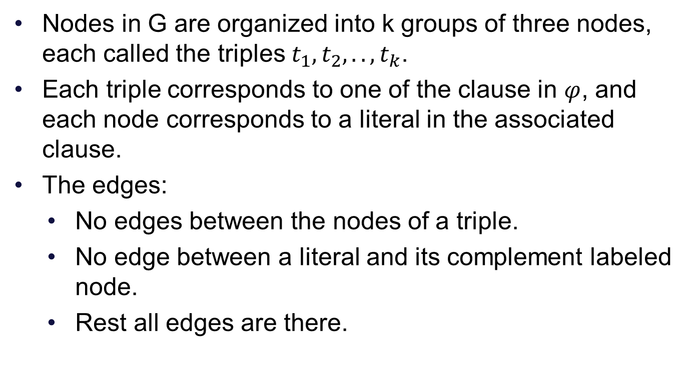
Construction
Nodes in G are organized into k groups of three nodes, each called the triples $t_{1},t_{2},..,t_{k}$.
Each triple corresponds to one of the clause in $φ$, and each node corresponds to a literal in the associated clause.
The edges:
No edges between the nodes of a triple.
No edge between a literal and its complement labeled node.
Rest all edges are there.

Slide 6










Example
$φ=(x_{1}∨x_{1}∨x_{2})∧$ $\left(\overline{x_{1}}∨\overline{x_{2}}∨\overline{x_{2}}\right)∧\left(\overline{x_{1}}∨x_{2}∨x_{2}\right).$
$$\overline{x_{1}}$$
$$\overline{x_{2}}$$
$$\overline{x_{2}}$$
$$x_{1}$$
$$\overline{x_{1}}$$
$$x_{1}$$
$$x_{2}$$
$$x_{2}$$
$$x_{2}$$

Slide 7
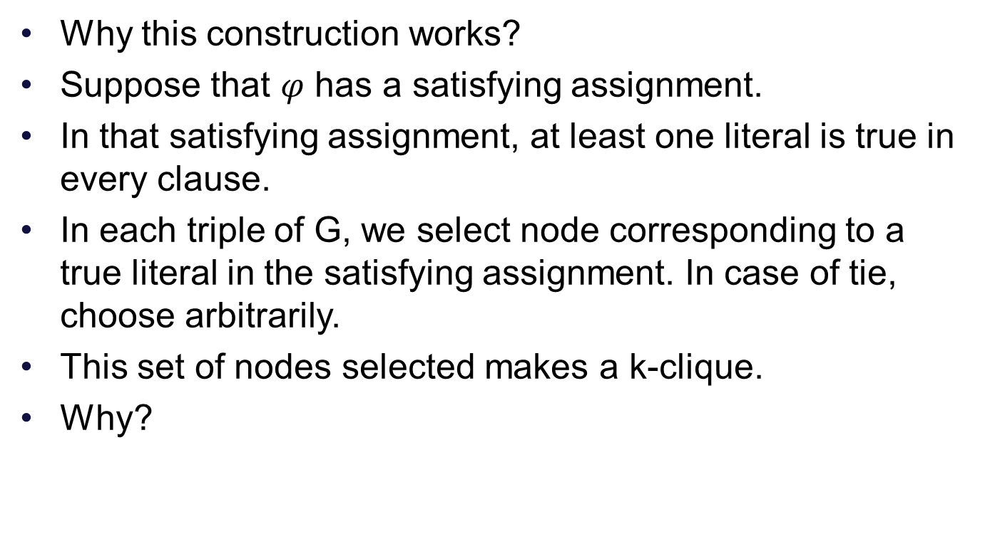
Proof
Why this construction works?
Suppose that $φ$ has a satisfying assignment.
In that satisfying assignment, at least one literal is true in every clause.
In each triple of G, we select node corresponding to a true literal in the satisfying assignment. In case of tie, choose arbitrarily.
This set of nodes selected makes a k-clique.
Why?

Slide 8
Why?
First we have selected k nodes.
Each pair of node is connected by an edge because if they do not have an edge will mean
They are in same triple. This cannot happen as k nodes are chosen from different triples.
They are labeled with a literal and its complement. This cannot happen in a satisfying assignment.
Therefore G contains a k-clique.

Slide 9
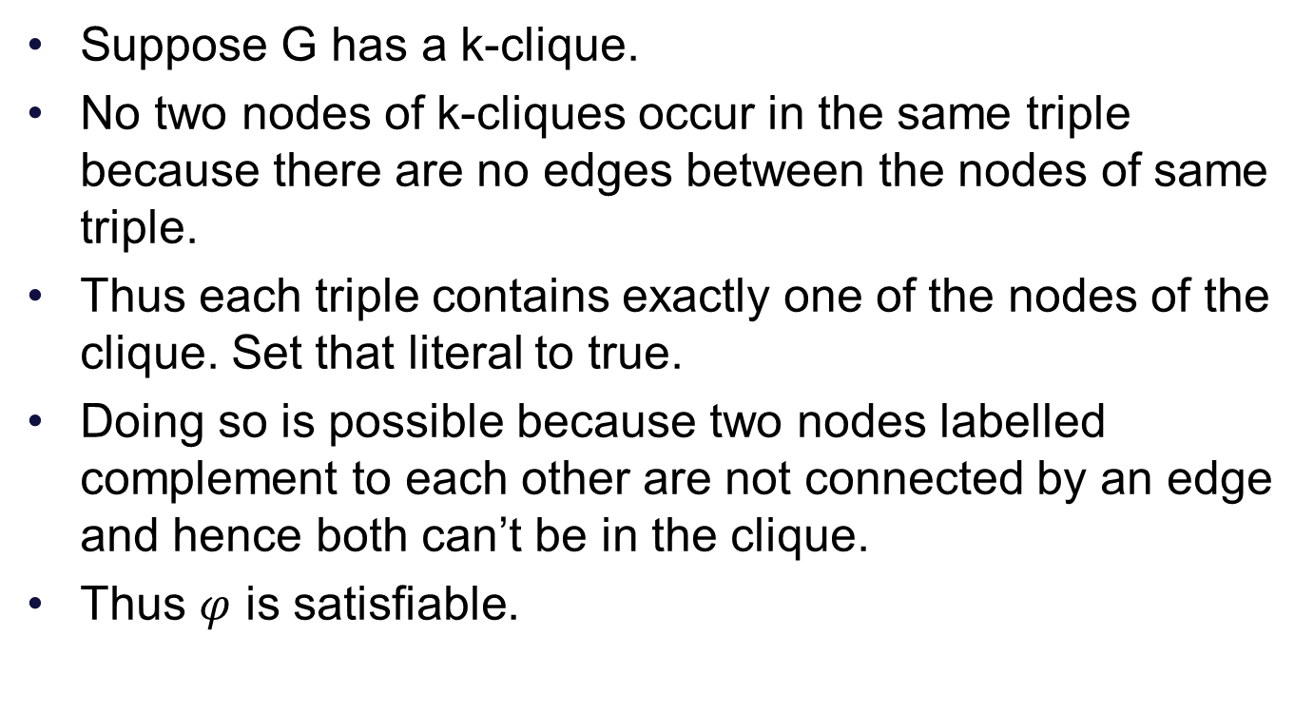
Proof
Suppose G has a k-clique.
No two nodes of k-cliques occur in the same triple because there are no edges between the nodes of same triple.
Thus each triple contains exactly one of the nodes of the clique. Set that literal to true.
Doing so is possible because two nodes labelled complement to each other are not connected by an edge and hence both can’t be in the clique.
Thus $φ$ is satisfiable.

